Slide 1


GNN-Based Recommender System and Sentiment Analysis for Video Games on Amazon
SDSC 4016 Project
Group Member:

Slide 2
Outline
Contents
01.
Motivation
Recommender System and Classical Methods
Deep Learning Methods: GNN
02.
Background
Existing Works of GNN-Based RS
NGCF
LightGCN
03.
Extra Feature
Sentiment Analysis
04.
Contents
Contents of the Final Report
05.
Plans and Teamwork
06.
References

Slide 3

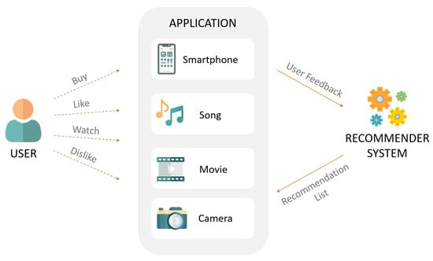

Motivation: Intro to Recommender System
Recommender System: A subclass of information filtering system that provides suggestions for items most pertinent to a particular user.
Recommendation System
Content Based
Collaborative Filtering
Hybrid System
Deep Learning-Based
Part 1. Motivation

Slide 4
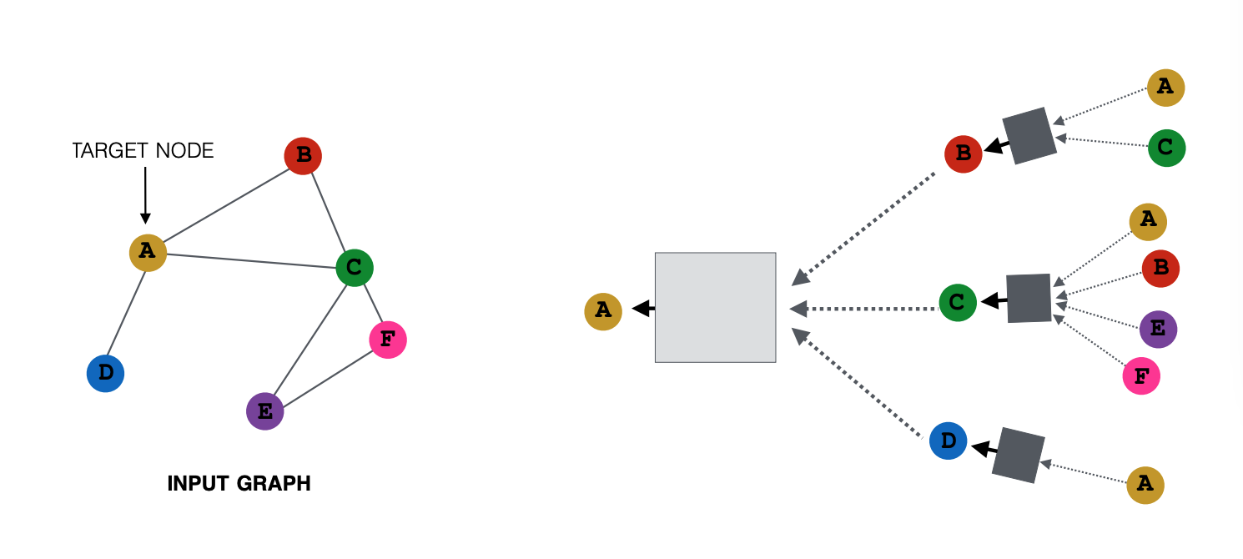
Motivation: GNN in RS
Graph neural networks were designed to process graph-structured data.
They use neural networks to operate on nodes and edges in a graph, encoding the relationship between nodes and learning patterns in the graph structure.
Data in Rec.sys has graph structure: User-item Bipartite Graph representation
Part 1. Motivation

Slide 5
Existing works of GNN-based RS
User-item Collaborative Filtering
Sequential Recommendation
Social Recommendation
Collaborative Filtering:
Graph convolutional matrix completion. Berg, R. V. D., Kipf, T. N., & Welling, M. (2017). (KDD'18)
Neural graph collaborative filtering. Wang, X., He, X., Wang, M., Feng, F., & Chua, T. S. (2019). (SIGIR'19)
LightGCN: Simplifying and powering graph convolution network for recommendation. He, X., Deng, K., Wang, X., Li, Y., Zhang, Y., & Wang, M. (2020, July). (SIGIR'20)
…...
Part 2. Background

Slide 6
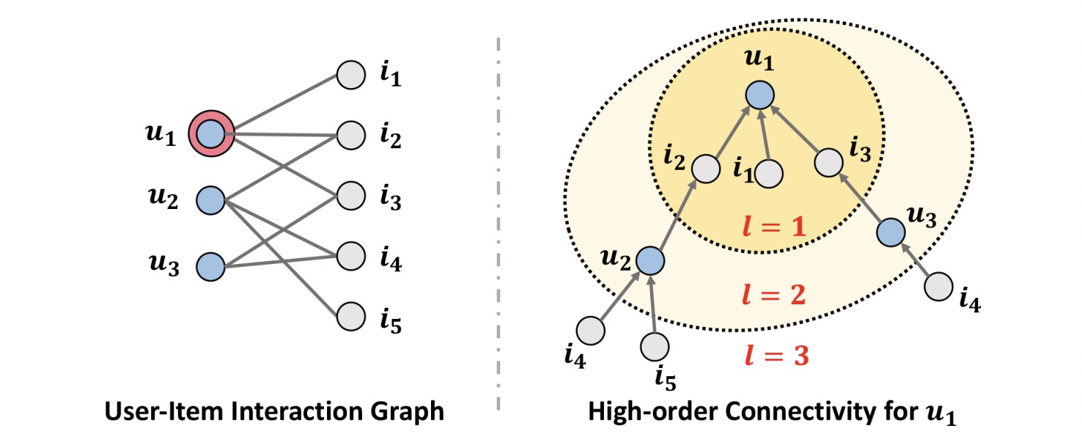
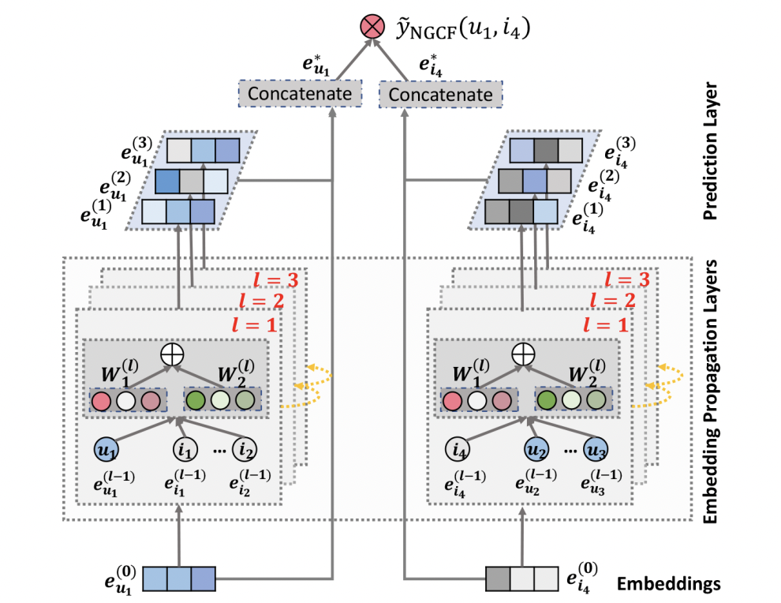
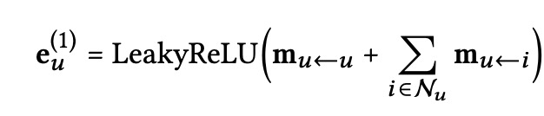
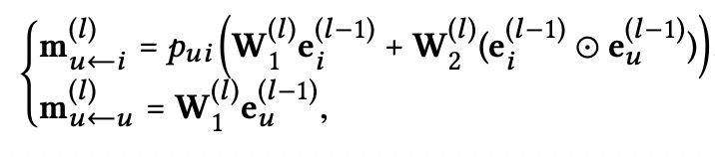
NGCF
Integrate the user-item interactions — more specifically the bipartite graph structure — into the embedding process
exploits the user-item graph structure by propagating embeddings on it.
Part 2. Background

Slide 7
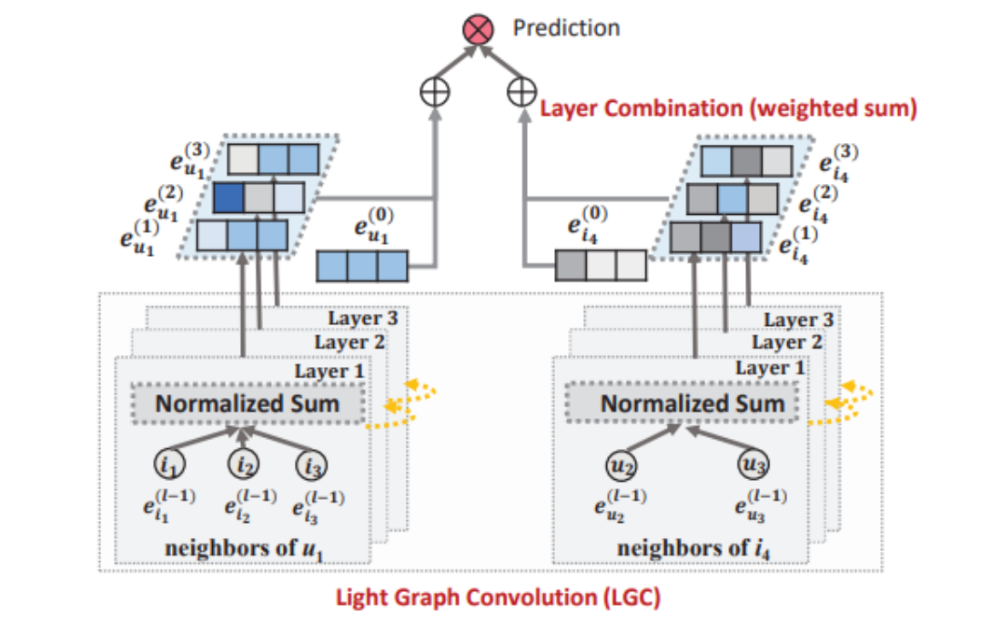
LightGCN
A model including only the most essential component in GCN -- neighborhood aggregation, which is for collaborative filtering.
Learns user and item embeddings by linearly propagating them on the user-item interaction graph.
Weighted sum of the embeddings learned at all layers as the final embedding.
Exhibits substantial improvements over Neural Graph Collaborative Filtering (NGCF) under exactly the same experimental setting.
Part 2. Background

Slide 8
Sentiment Analysis
Sentiment Analysis: A text classification tool that analyzes the information received and tells whether the underlying sentiment is positive, negative, or neutral.
Existing Approaches:
Knowledge-based Techniques
Classify texts based on the presence of explicit affective words, such as happy, sad, fearful and bored.
Statistical methods
Use Machine learning algorithms to generate models based on extracted text features and sentiment labels to make predictions.
Hybrid
Combine the ideal elements of knowledge-based techniques and statistical methods to improve predictive accuracy.
Part 3. Extra Future

Slide 9
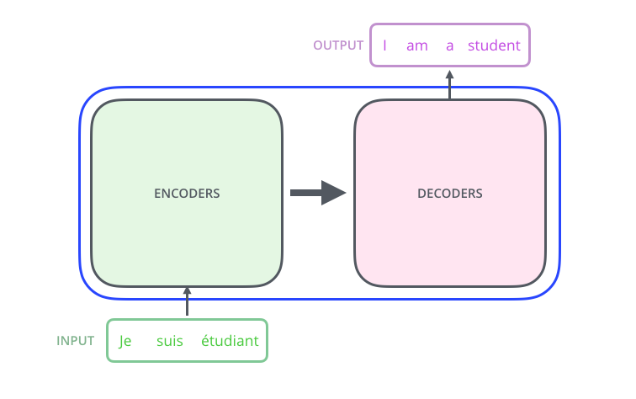
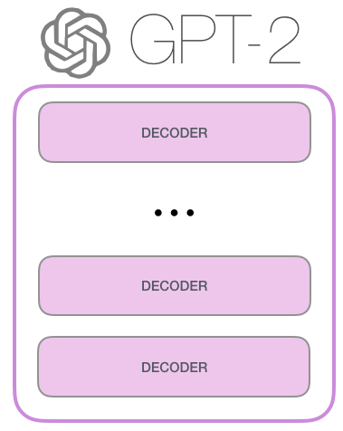
Transformer-based Sentiment Analysis
Transformer is a deep learning model, which contains two parts, an encoder, and a decoder, and uses a "self-attention" mechanism to learn the relationships between words in different positions in the sentence.
GPT-2 is a large-scale, transformer-based, pre-trained model on a huge training set, built using only transformer decoder blocks, and has achieved excellent performance.
We will use GPT-2 to perform pre-processing processes such as tokenization, and word embedding on text data, and then build a classification layer on top of the GPT-2 model for sentiment analysis.
Part 3. Extra Future

Slide 10
Contents in Final Report
Methodology
Experiments
Illustration of key mechanisms of GNN methods
Experiments and results regarding performance comparison of different GNN methods and parameters fine tunning
2
3
Main Works
Further Improvement
Implementation of a representative GNN based Recommendation system
Possible improvement and future directionPossible improvement and future direction
1
Final
4
Report of
SDSC 4016
Part 4. Contents in Final Report

Slide 11
Our Plans
Experiments & Conclusion
Conduct experiments, solve remaining problems, write the report.
Model Training
Paper Reproduce
Build the RS from scratch and the NLP model.
Try to reproduce relevant papers included in the reference list.
Week 9-10
EDA
Data preprocessing and exploration. Finding problems/ideas generation.
Week 5-6
Week 7-8
Week 3-4
Part 5. Plans and Teamwork

Slide 12
Teamwork
SDSC 4016 Group 5
GNN-Based Recommender System and Sentiment Analysis for Video Games on Amazon.
Yang Wentao
ZHOU Jinyu
ZHOU Xin
Build GNN-Based RS (NGCF, LightGCN)
Conduct Experiments
Sentiment Analysis
NLP Transformer Model Training
Build Collaborative Filtering-Based RS (item/userCF, SVD)
Report & Powerpoint
Part 5. Plans and Teamwork

Slide 13
References
[1] Ni, J., Li, J., & McAuley, J. (2019). Justifying recommendations using distantly-labeled reviews and fine-grained aspects. Proceedings of the 2019 Conference on Empirical Methods in Natural Language Processing and the 9th International Joint Conference on Natural Language Processing (EMNLP-IJCNLP). https://doi.org/10.18653/v1/d19-1018
[2] Deng, K., Huang, J., & Qin, J. (2020). GCN-ICF: Graph convolution networks for item-based recommendation. 2020 IEEE/WIC/ACM International Joint Conference on Web Intelligence and Intelligent Agent Technology (WI-IAT). https://doi.org/10.1109/wiiat50758.2020.00018
[3] He, X., Deng, K., Wang, X., Li, Y., Zhang, Y., & Wang, M. (2020). LightGCN. Proceedings of the 43rd International ACM SIGIR Conference on Research and Development in Information Retrieval. https://doi.org/10.1145/3397271.3401063
[4] Tabinda Kokab, S., Asghar, S., & Naz, S. (2022). Transformer-based deep learning models for the sentiment analysis of social media data. Array, 14, 100157. https://doi.org/10.1016/j.array.2022.100157
Part 6. References

Slide 14
Thank you!
Your Questions are Welcome

